Slide 1
Ecstasy Should Be Used As a Therapeutic Tool to Assist Psychotherapy for the Treatment of Post-Traumatic Stress Disorder
By Tim Maloney

Slide 2
History of PTSD
5th century B.C.- “ The Trembler”
1860- “Nostalgia”
1866- “Railway spine”
1914-1918 “ Shell Shock”
1980 -The DSM-III recognizes PTSD as a disorder

Slide 3
History of MDMA
1912- Anton Köllisch from Merck Pharmaceuticals synthesized MDMA for the first time
1976 - Alexander Shulgin and David Nichols published the first report on MDMA’s psychotropic effect in humans
May 31, 1985 -MDMA banned federally, and lists MDMA as a class I drug
March 22, 2010-The MAPS Organization receives FDA approval to begin research with MDMA along with psychotherapy to treat PTSD

Slide 4
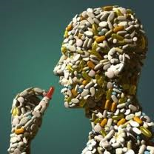
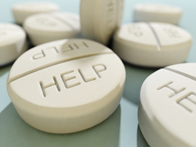
Current drug therapy for PTSD
Benzodiazipine
Zoloft
Paxil

Slide 5
Current Psychotherapy
Exposure Therapy
EMDR
emphasizing the reduction of avoidance through repeated exposure exercises
8-15 Sessions
combines the exposure element, the cognitive element, and relaxation techniques while the eyes of the participant are gazed upon a mobile point or figure moving from side to side

Slide 6
Cognitive Therapy / Relaxation Training
concentrates on challenging automatic or acquired beliefs (safety or trust) connected to the traumatic experience, and then cognitively restructuring the mind
“breathing retraining,” muscle relaxation, “cognitive elements”, and exposure techniques to help treat PTSD

Slide 7
Efficiency of current PTSD treatments
Study comparing efficiency of EMDR, Relaxation, & Exposure therapy
15 participants in each group
8 Sessions

Slide 8
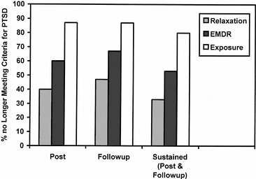

Slide 9
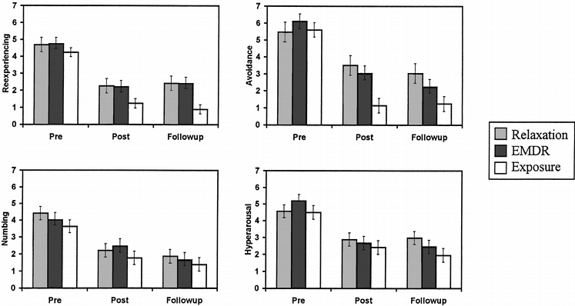

Slide 10
Efficiency
EMDR
Cognitive Therapy
Time and time again research has shown EMDR to be equivalent or superior to ET in its effectiveness, but generally the EMDR takes 40-100 hours of “homework” longer to achieve its prime effectiveness
Another study found shows after 12 session of EMDR 77% of its participants showed a complete elimination of the PTSD diagnosis (Carlson, 1998)
With these therapies showing large numbers, the effectiveness of CT can be seen in there shadows, as in a study that compared present-focused group therapy and CT the results showed 40% of all participants had a significant change in PTSD symptoms

Slide 11
MDMA
MDMA is a central nervous system stimulant that falls under Amphetamine-type stimulant group (ATS)
The common effects of MDMA come from its ability to bind the strongest to serotonin transporters inducing a speedy release of serotonin and dopamine

Slide 12
MDMA Why?
MDMA is effective, and is a great tool to assist in psychotherapy for PTSD, for its prime effectiveness for treatment comes from “reducing the fear response to a perceived emotional threat (Stevens 1999/2000).” The results have shown in many ground breaking studies with people dealing with difficult life events.

Slide 13
MDMA with Psychotherapy
In the study 12 participants diagnosed with PTSD went through two eight- hour psychotherapy sessions with MDMA scheduled 3-5 weeks apart. The results showed over 80% no longer qualified by DSM as having PTSD
a 100% success rate after two more eight hour sessions
The control group not receiving the MDMA treatment, but instead took a placebo had only a 25% success rate after the two eight-hour
all three of the subjects who reported having PTSD to the point where they could not work, were able to return to work after the study.

Slide 14
Positive Effect
The beneficial effects can be seen in the user’s positive moods, cognitions, beliefs, empathy, and reduced fear (Parrott, 2007). MDMA may help a person establish a deeper contact with their true self, as well as an increased ability to recognize positive characteristic of the self (Nichols 1986). Where Metzner (1998) found MDMA has the ability to make one become more empathetic and bond stronger with others. Parrot (2007) combines many different studies showing MDMAs ability to promote Euphoric and elated moods, an increase interpersonal feelings, love, increased sensuality, and increase sense of touch.

Slide 15
Immediate Negative Effects
Cardiovascular functioning
Hyperthermia
Death toll 160
Overdose
247 in 1994, 422 in 1995, 319 in 1996, 637 in 1996, 637 in 1997, 1142 in 1998, 2850 in 1999 and 4511 in 2000

Slide 16
Long Term Effects
Lesions on serotonergic nerve terminals
recall tests
verbal and visual memory
short term memory
cognition

Slide 17
Future Implications
The real future lies in the MAPS organization where it is in the middle of a 10 year-$10 Million plan to make MDMA into a government approved and regulated prescription for MDMA.

